Slide 1
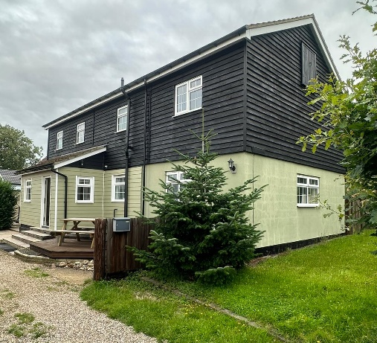
Duncannons
Inclusive Support 2 Limited

Slide 2
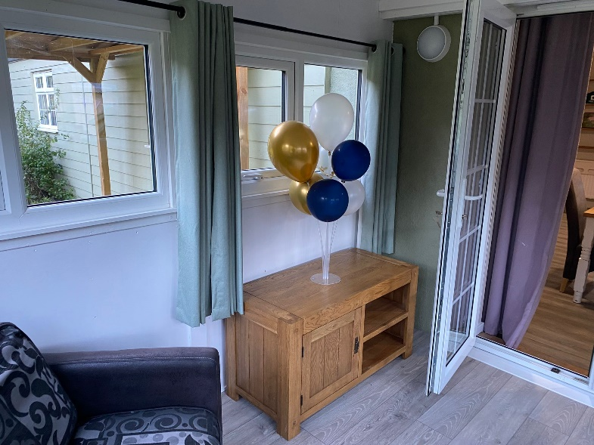
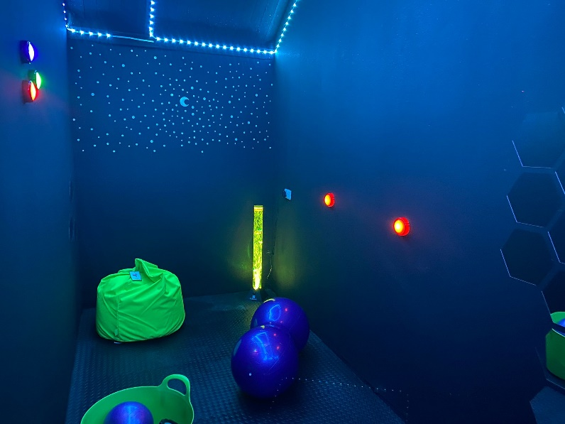
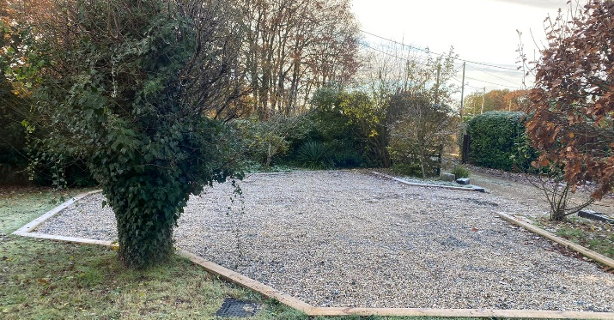
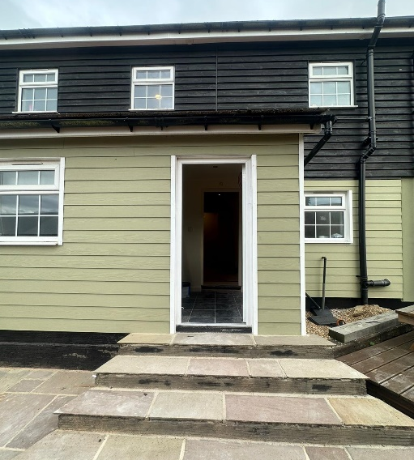
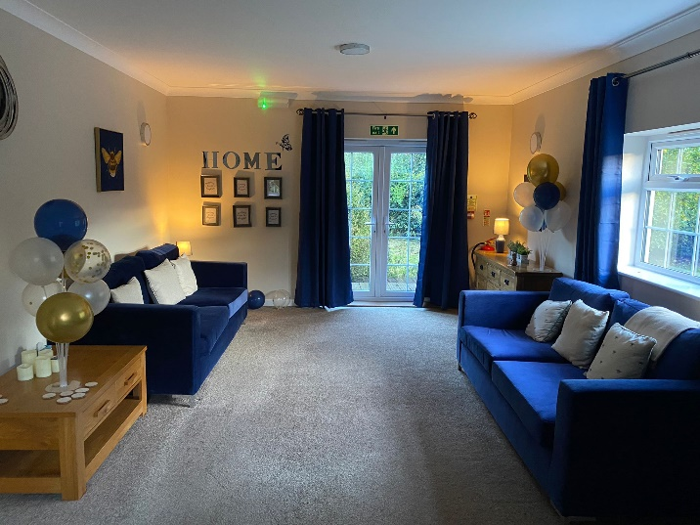
Welcome! Registered with CQC and Onboarded with Essex County Council.

Slide 3
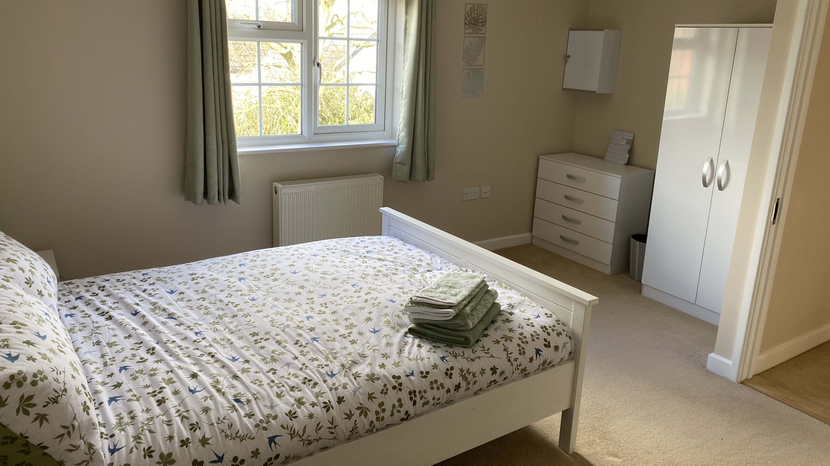
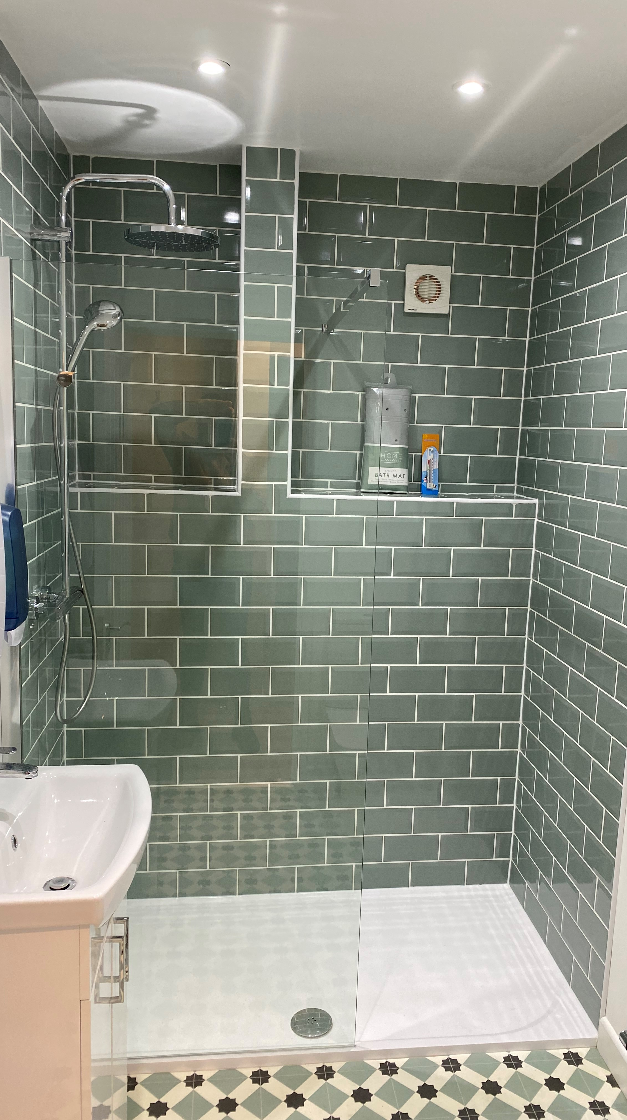
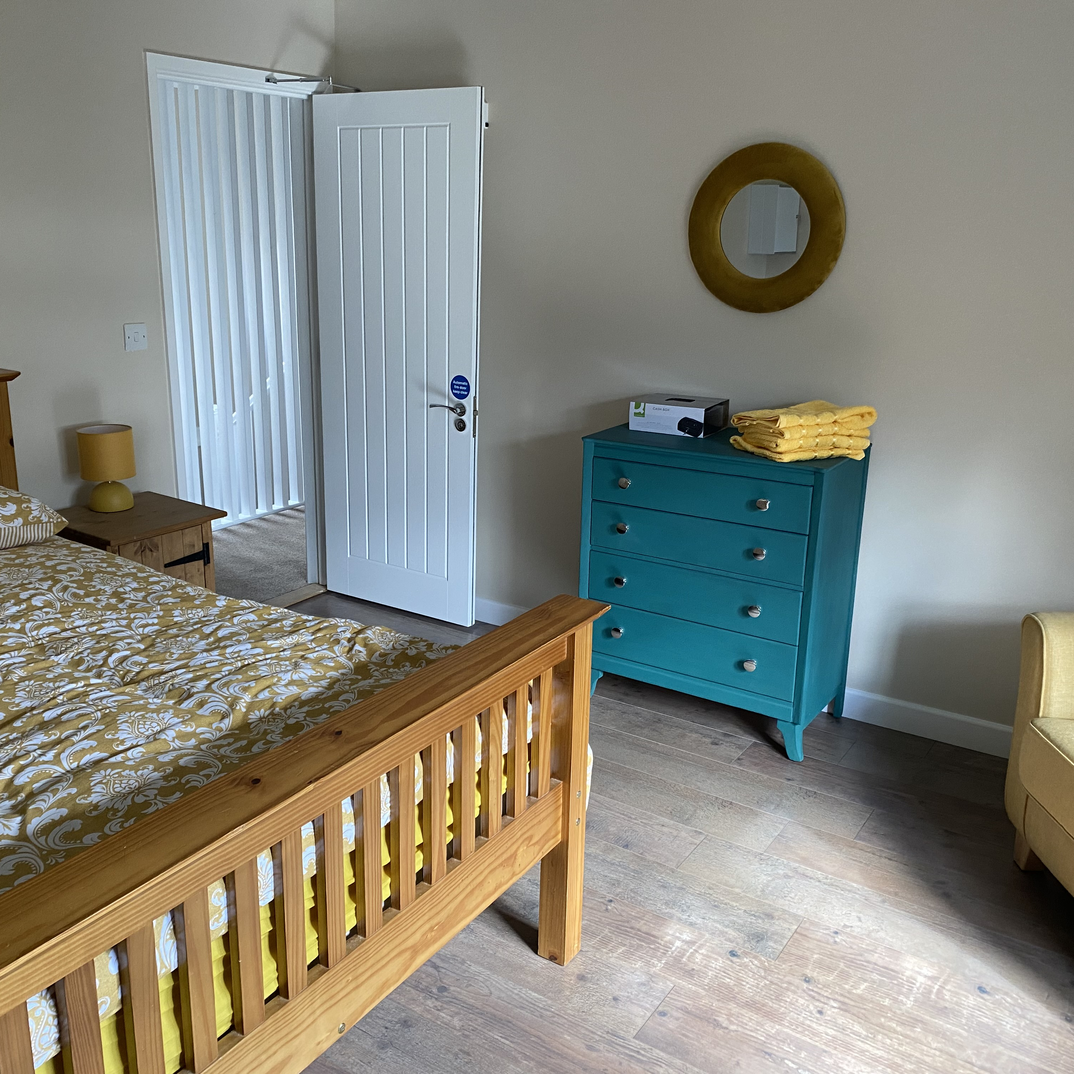
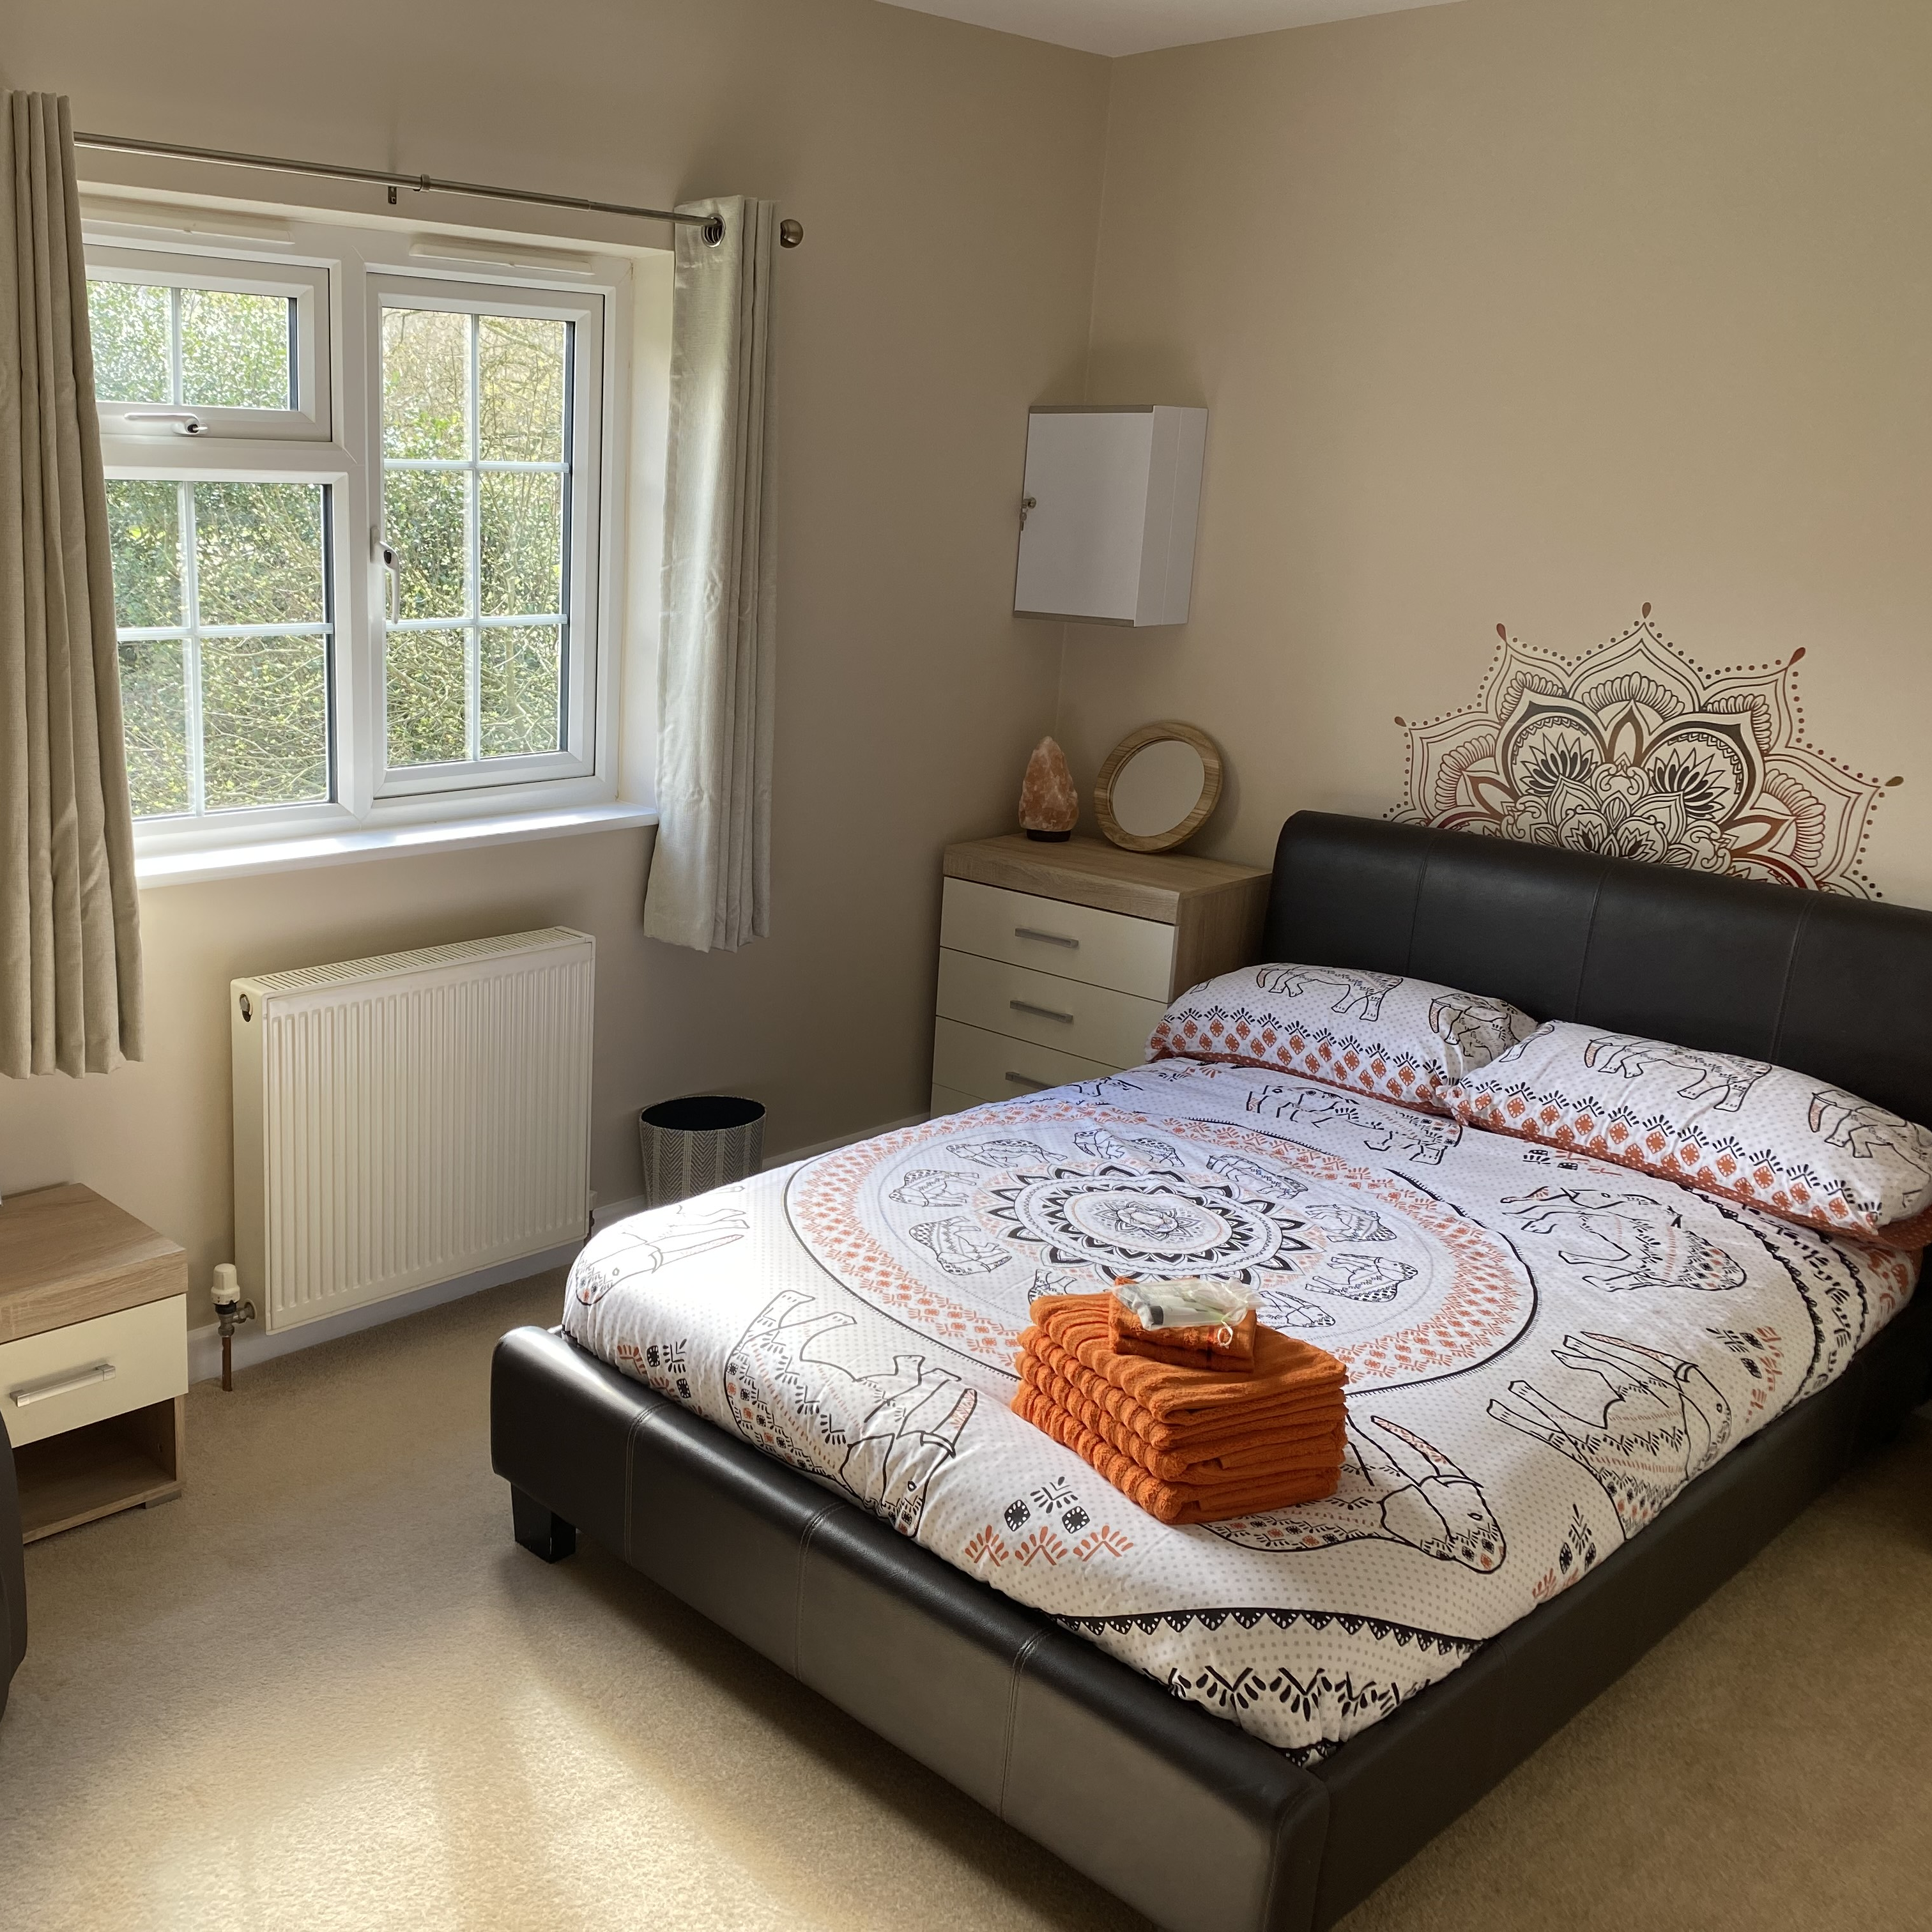
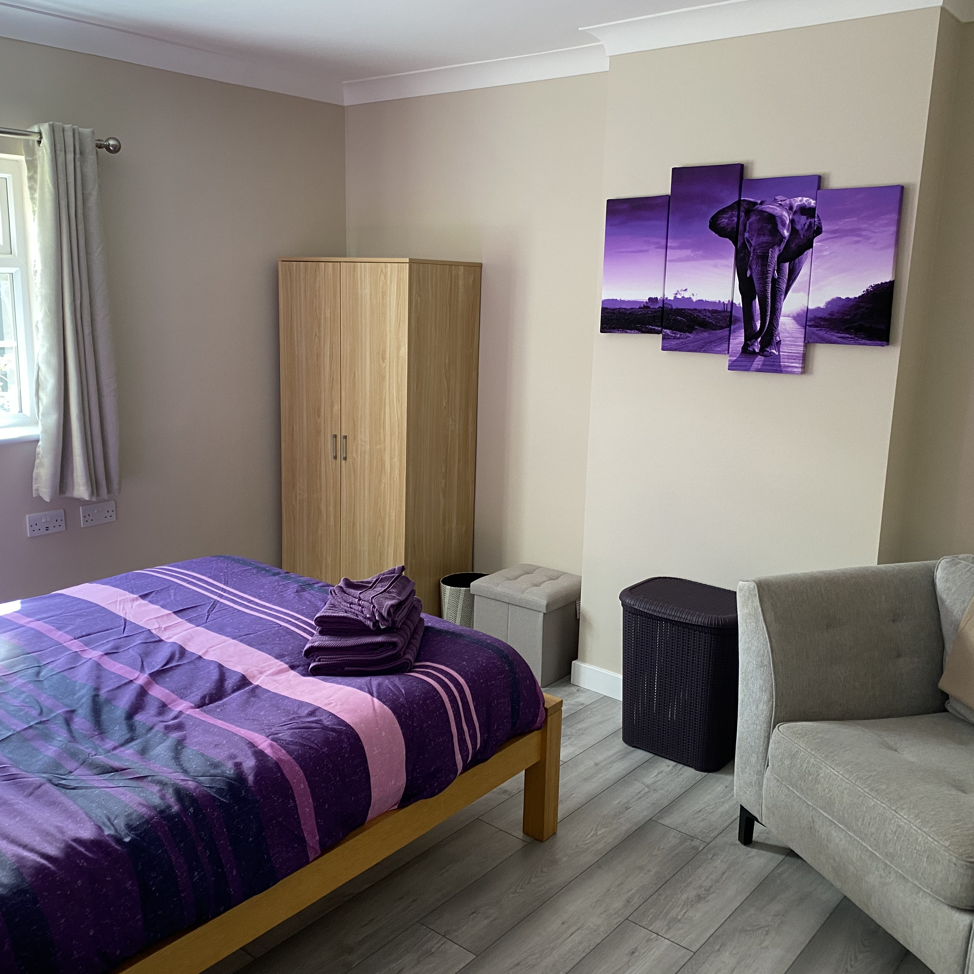
Interior

Slide 4
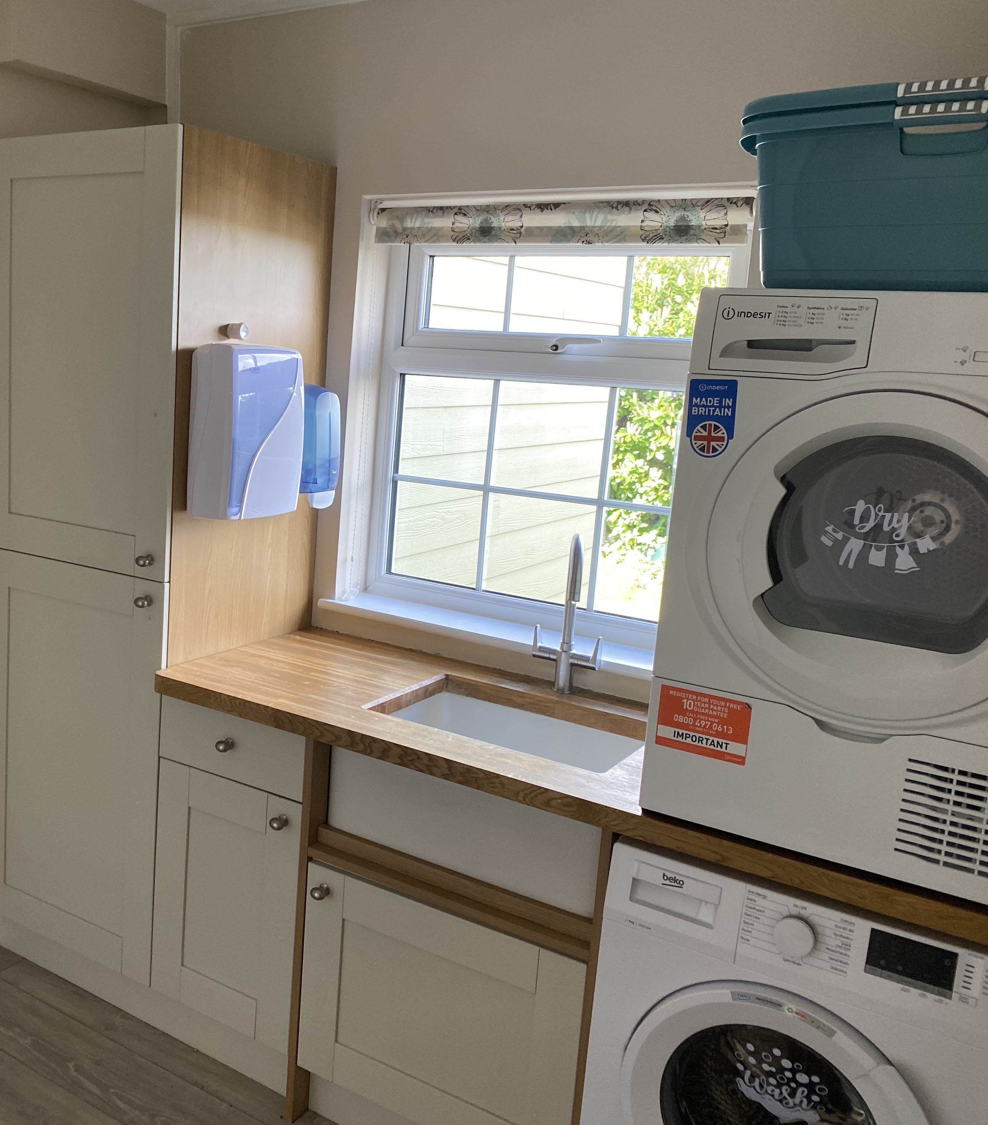
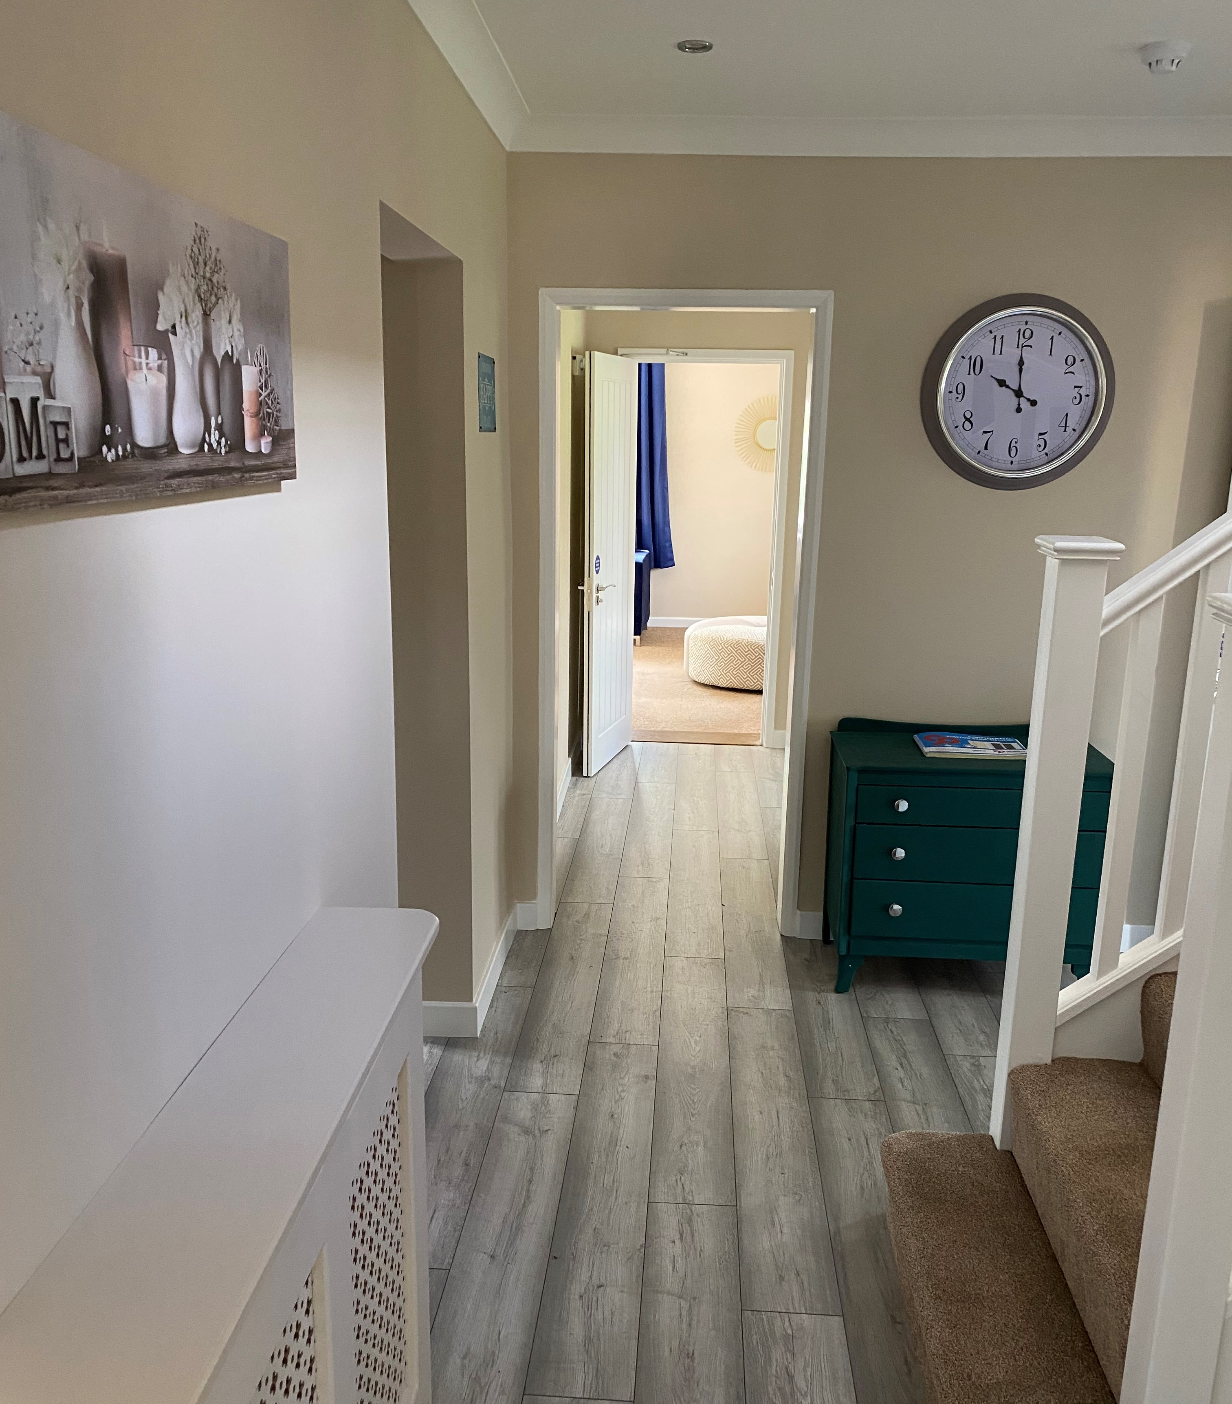
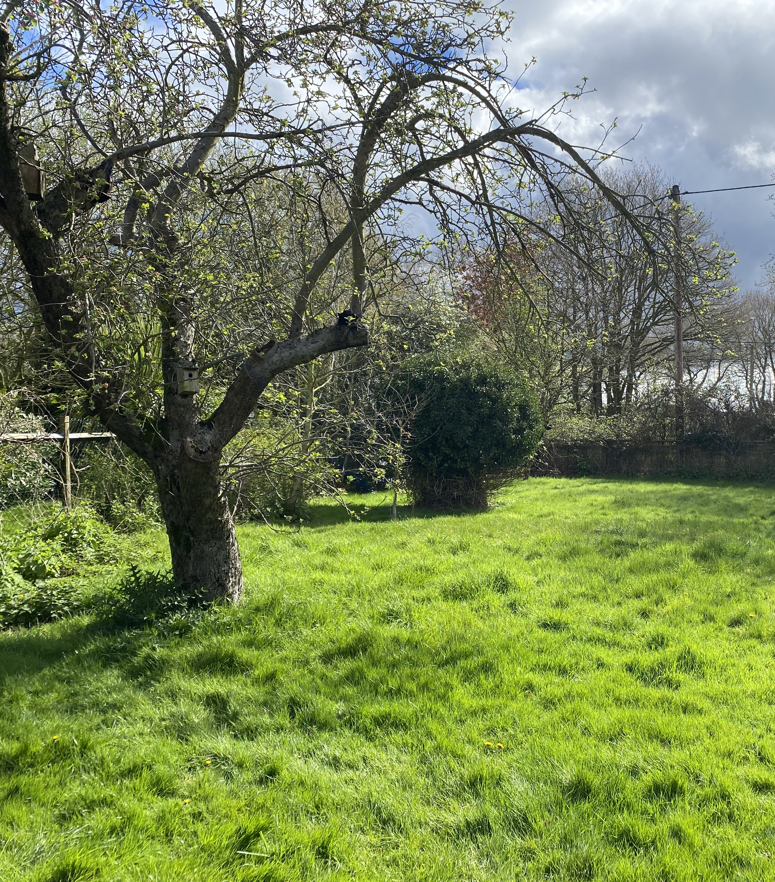
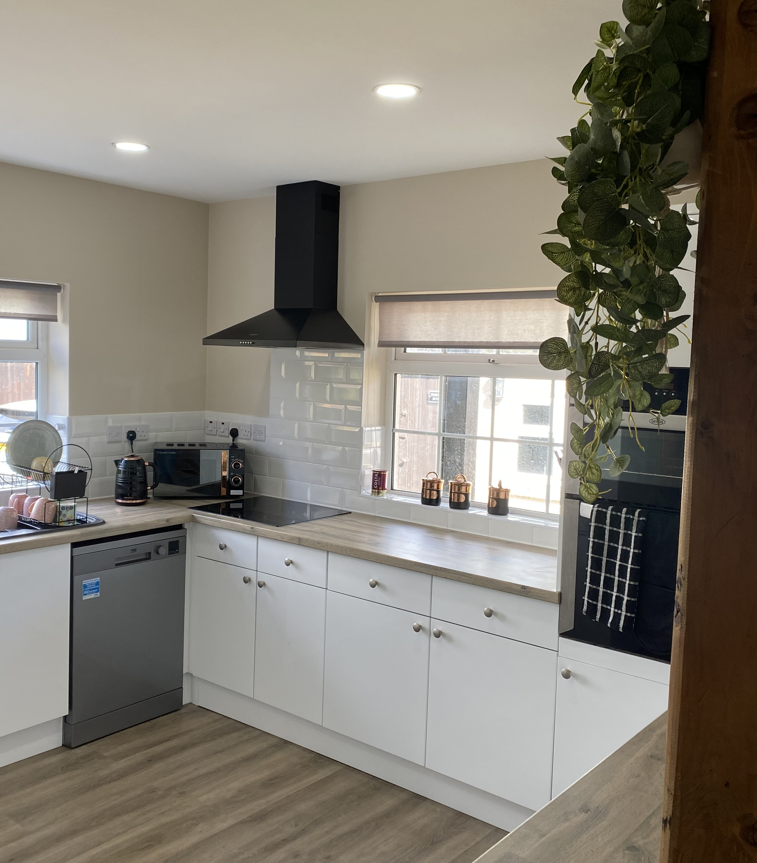
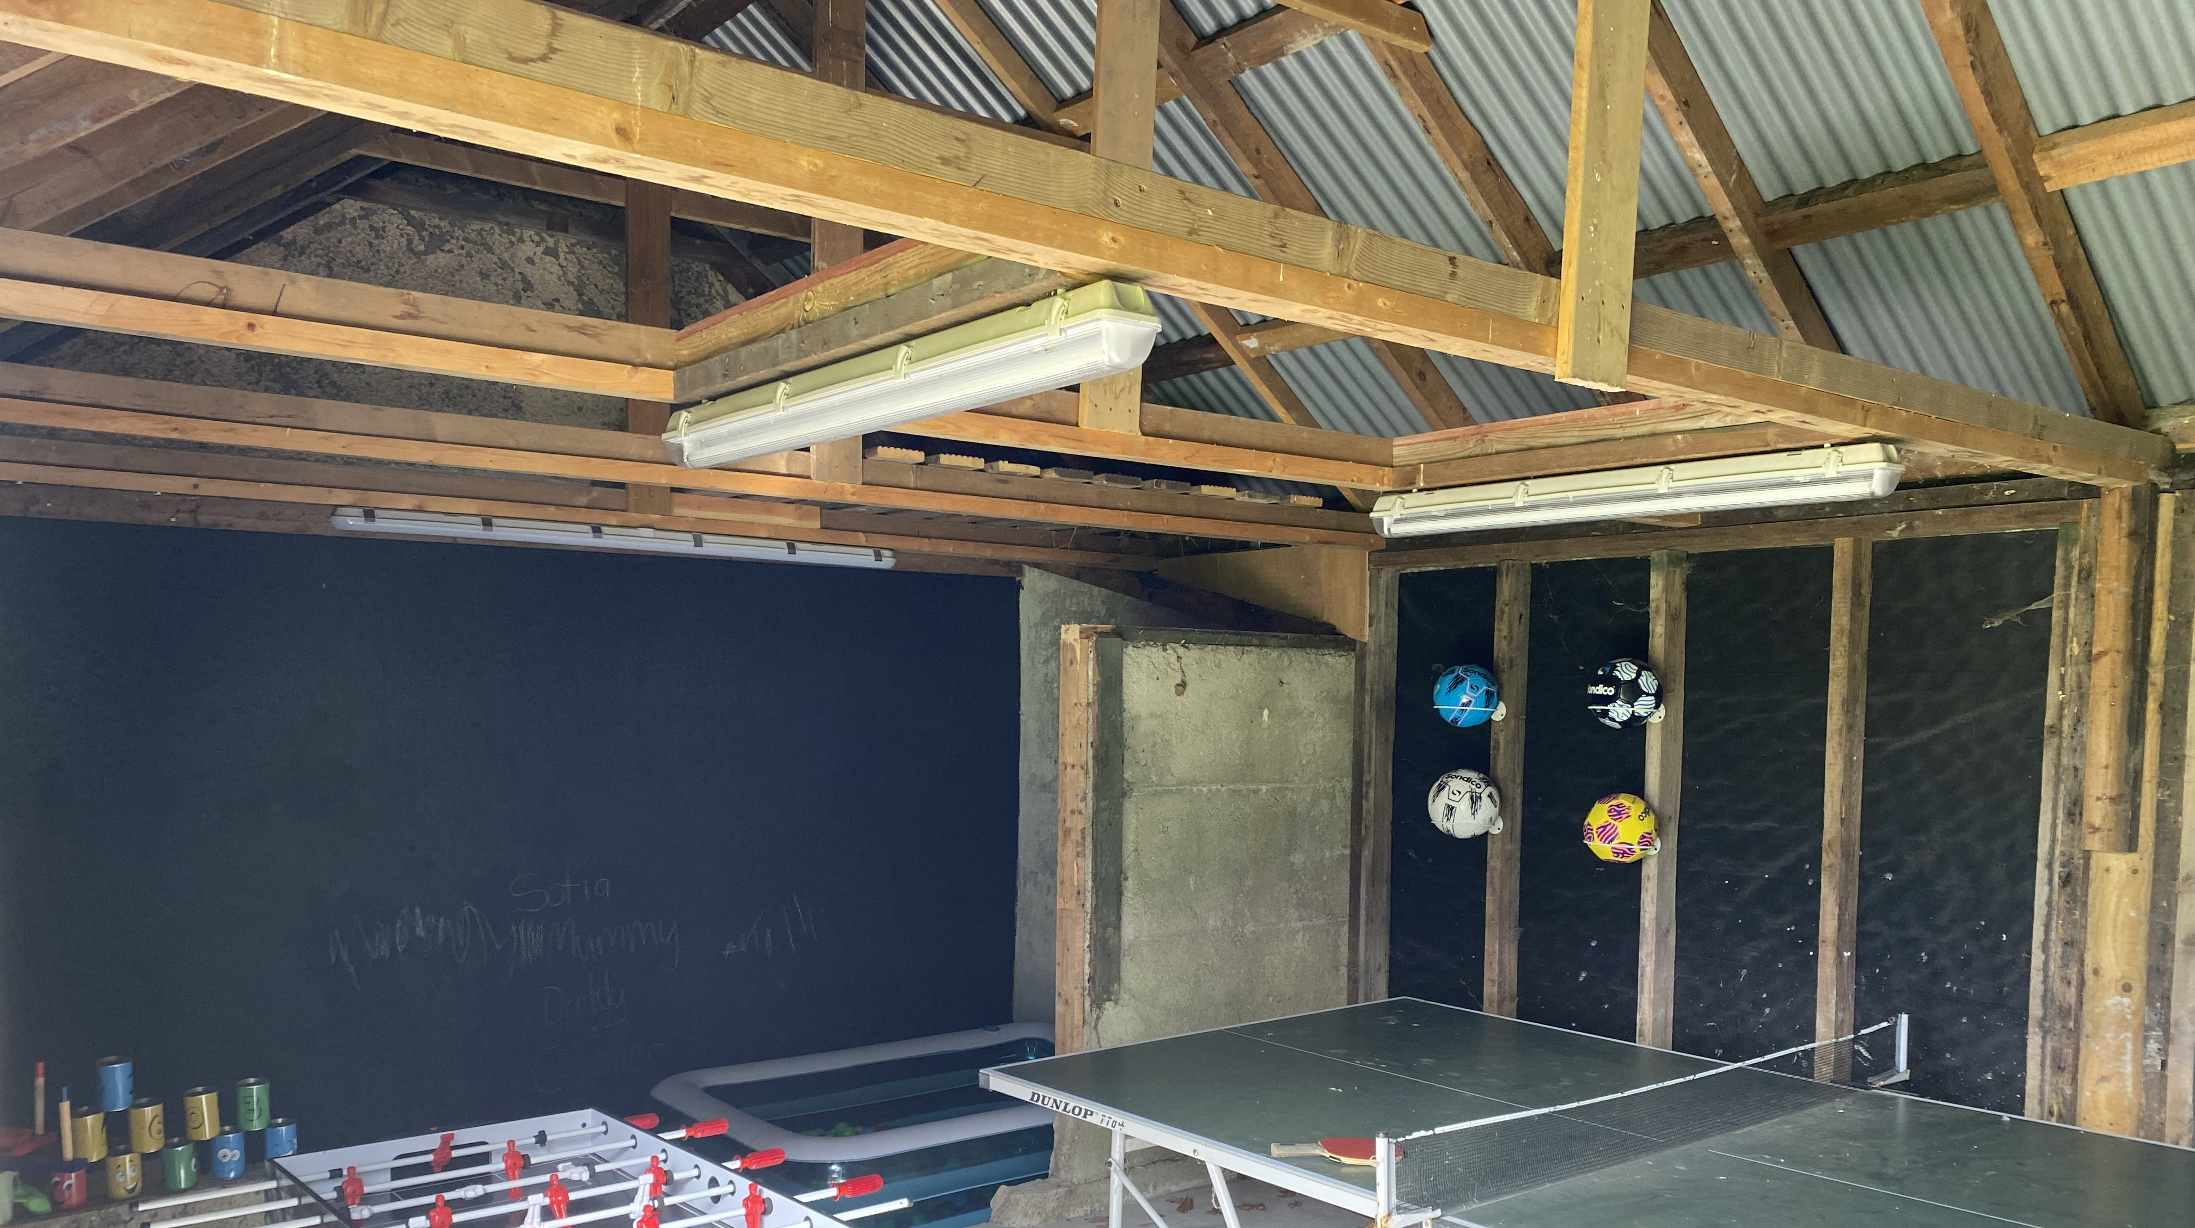
Ground Floor and Outside

Slide 5
Residential Care Home for 6 Adults with a learning disability – Complex/Non-Complex
6 Bedrooms
One bedroom with en-suite and dressing area/gaming/sensory area and walk in wardrobe
2 ground floor bedrooms
Large lounge
Spacious kitchen/diner
Garden room
Enclosed garden space with gardening project being developed and privacy with neighbours one side only.
Separate laundry facilities
Sensory Room
Outside office space
0.9 miles from Tesco express
On a main bus route

Slide 6
Contact:
Registered Manager: Liz Buckley-Saxon
liz@inclusivesupportltd.co.uk
07718133059
Operational Manager: Chelsey Mitchell
Chelsey.Mitchell@inclusivesuportltd.co.uk
07507704495

